Slide 1

AGGREGATION and COMPOSITION

Slide 2

ASSOCIATION
Indicates the relationship bet. objects
Rep. a gen. relationship that describes an activity bet. 2 classes
Allows objects to call methods in other objects thru ptr variables.
See Ex.1 No.1 Pg. 172

Slide 3
AGGREGATION
a class is a member of a class
Supports the modeling of ‘has a’ relationship between classes
See Ex.1 No.2 Pg. 173-174

Slide 4
COMPOSITION (1/2)
Models a whole/part relationship with a strong ownership; when the whole dies, the part does so as well
An object can be only part of one whole object
The whole part is responsible for creation and destruction of its part

Slide 5
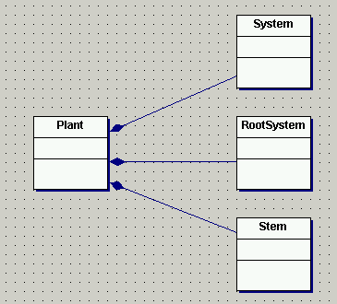
COMPOSITION (2/2)
See Ex.1 No.3 Pg. 175-176

Slide 6
Aggregation & Composition Implementation
There are two basic ways in which aggregations are implemented
Objects contain objects (fixed aggregation / composition)
Objects contain pointers to objects (variable aggregation)

Slide 7
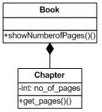
Fixed aggregations / Composition
Fixed aggregations / compositions are implemented by using a class type as an attribute type in the aggregate class.

Slide 8
Example of Fixed Aggregation (1/2)
class Chapter{
int no_of_pages;
public:
Chapter(int pages);
int get_pages();
};
Chapter::Chapter(int pages){
no_of_pages = pages;
}
int Chapter::get_pages(){
return no_of_pages;
}
Constructor for Chapter
class takes an integer
argument to define
its pages

Slide 9
Example of Fixed Aggregation (2/2)
Class attributes now
include objects of
other classes
class Book{
public:
Chapter c1, c2, c3, c4;
Book(int pages1, int pages2, int pages3,
int pages4):c1(pages1), c2(pages2),
c3(pages3),c4(pages4){ }
void showNumberofPages();
};
void Book:: showNumberofPages(){
cout<<"Total number of pages" <<
(c1.get_pages() + c2.get_pages()+
c3.get_pages() + c4.get_pages());
}
int main(){
Book TP2(200, 190, 50, 100);
TP2.showNumberofPages();
}
Note use of colon(:) operator to pass parameters sent to
constructor of aggregated
object to the constructors
of the constituent objects
Book class methods
can now call methods
of the Chapter objects

Slide 10
Variable Aggregations (1/2)
A component may not always be present at runtime. Therefore, we may represent it using a pointer to an object rather than by an object itself.
Example:
A lecturer may be assigned a course to teach. That lecturer may be removed from that course at anytime. The relationship is one that may change. Hence a fixed aggregation / composition is unsuitable for representing this relationship. Variable aggregation is more suitable

Slide 11
Variable Aggregations (2/2)
Variable aggregation - declare attributes as object pointers rather than standard data types.
Pointers can be set to NULL to represent no object
class car
{
private:
person * theDriver = NULL;
..};
Class attributes now
include pointers to
objects of other classes

Slide 12
Example of Variable Aggregation (1/3)
We could have a method
which instantiates an object
of the contained class
and allocates it to the
pointer like this..
car::addDriver(){
theDriver=new person;
}
car::removeDriver(){
delete theDriver;
theDriver=NULL;
}
..and deletes it like this

Slide 13
Example of Variable Aggregation (2/3)
#include <iostream>
#include <string>
using namespace std;
class Person{
string name;
public:
Person(string name=" "){
this->name=name;
}
void set(string a){
name=a;
}
void print() {
cout<<name<<endl;
}};
class Car
{ string model;
string year;
Person *driver;
public:
Car(string model=" ",
string year=" ");
void addDriver();
void deleteDriver();
void print();
};

Slide 14
Example of Variable Aggregation (3/3)
void Car::print(){
driver->print();
cout<<model<<endl;
cout<<year<<endl;
}
int main(){
Car car1("Honda","2006");
car1.addDriver();
car1.print();
}
Car::Car(string a, string b){
model=a;
year=b;
}
void Car::addDriver(){
driver=new Person;
driver->set("Ani");
}
void Car::deleteDriver(){
delete driver;
driver=NULL;
}

Slide 15
Aggregation in UML diagrams (fixed aggregation)
Draw relationship between a Point class and a Circle class.
A point is an aggregate of the circle. When the circle class is destructed so will the point class.
Aggregate symbol used is darkened diamond.

Slide 16
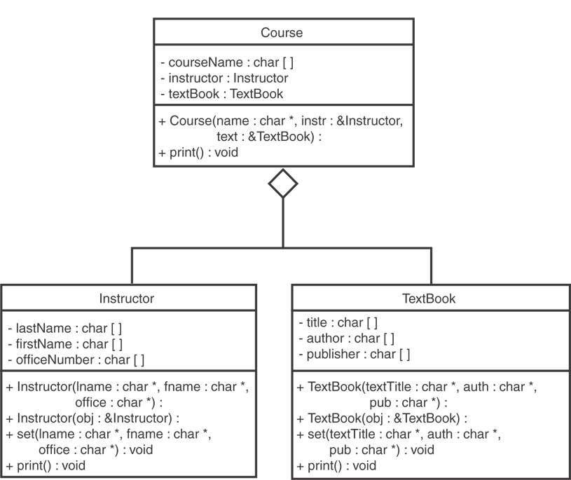
Aggregation in UML diagrams (variable aggregation)

Slide 17
Exercises
Refer to Exercise 2 No.1 in Lab 7 pg. 176-178 (association)
Refer to Exercise 2 No.2 in Lab 7 pg. 178 (composition)
Refer to Exercise 2 No.3 in Lab 7 pg. 178-179 (aggregation)
Submit Ex.2 No.3 (by end of Thursday 7th May)

